Slide 1

Leatherhead Bonsai
Club
A PowerPoint presentation on the basics of bonsai

Slide 2



What is Bonsai?
Bonsai is the Japanese art of growing miniature trees in containers through techniques like pruning, root restriction, and careful shaping. It is not a specific species of tree, but rather a horticultural practice used to create a miniaturized, aesthetically pleasing representation of a full-sized, mature tree. The name literally translates to " "planted in a container" in Japanese.

Slide 3
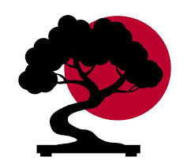
Key Concepts
Not a specific species: A common misconception is that bonsai is a type of genetically dwarfed tree. Nearly any perennial woody-stemmed tree or shrub species
can be used to create a bonsai.
Art form: The goal of bonsai is not just to keep a plant small, but to apply artistic design and horticultural techniques to evoke the essence and appearance of a full-sized, often old and weathered, tree in a natural landscape.
Techniques: The miniature size and mature appearance are achieved through careful and ongoing practices, including:
Pruning: Selective cutting of branches, buds, and leaves to control growth and shape.
Root reduction: Periodic root pruning to prevent the tree from becoming pot-bound and to manage overall size.
Wiring: Using wire to gently coerce branches and the trunk into specific artistic shapes and directions.
Repotting: Moving the tree into a small, often shallow, pot that complements its form.
Defoliation: The temporary removal of leaves to encourage smaller new growth.

Slide 4
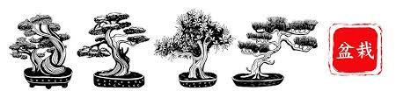
Bonsai is deeply rooted in Zen Buddhism and Japanese culture, where it is associated with a number of positive
traits and symbols:
Harmony and Balance: The aesthetic balance of the tree within its container is a central principle.
Patience and Discipline: The long process of nurturing a bonsai teaches patience and provides stress relief.
Strength and Resilience: The trees are often styled to look as though they have weathered harsh natural conditions, symbolizing the ability to overcome challenges.
Connection to Nature: Bonsai allows people to connect with nature on a miniature scale and reflect on its beauty and impermanence

Slide 5
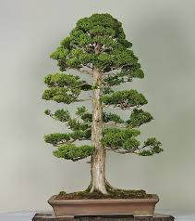
Bonsai styles
Formal Upright Style (Chokkan)
How to Achieve This Style
Start with a species that naturally grows straight; ideal choices include pines, junipers, and cryptomerias, which hold vertical form well.
Remove lower or crowded branches early to define a single, dominant trunk.
The first branch should be about one-third up the trunk, alternating sides as you move upward.
Ensure branches near the top are shorter and positioned closer together to maintain taper and proportion.
Use gentle wiring to guide branch placement without marking or bending the trunk to preserve its straight line.
Maintain taper by regularly pruning and pinching growth so the trunk thickens at the base and narrows toward the apex.
Encourage radial root spread by trimming roots and repotting every two to three years.
Use rectangular or oval pots, setting the tree slightly off-centre to enhance visual balance.
Prefer trees with naturally straight trunks to simplify training, prevent an artificial look, and keep the Chokkan style elegant and authentic

Slide 6
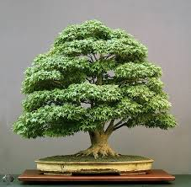
Bonsai styles
Broom Style (Hokidachi)
How to Achieve This Style
To create a bonsai broom style, Maples and Elms are ideal because they respond well to pruning and develop dense twigs.
Trunk formation – Grow a straight, upright trunk with minimal curves. Avoid tapering too sharply.
Branch development – Encourage branching about one-third up the trunk. Use light wiring to spread branches radially in every direction.
Pruning – Regularly prune to maintain a fine, even canopy. Trim back new shoots to promote ramification and density.
Pot selection – Choose a round or oval pot to enhance the symmetrical appearance.
Maintenance – Keep the canopy tidy through frequent trimming. Remove crossing branches and maintain good airflow to prevent crowding.

Slide 7
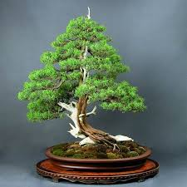
Bonsai styles
Informal Upright (Moyogi)
A very common style that reflects a tree in nature affected by elements, resulting in a naturally curved, non-linear trunk line.
Characteristics: The trunk has gentle, natural-looking curves, but the apex typically finishes above the center of the trunk's base.
How to Achieve:
Choose a species with a flexible trunk, such as a Juniper or Japanese Maple.
Use wiring techniques to form natural curves in the trunk while the tree is young and pliable.
Ensure each bend looks organic, not forced or perfectly S-shaped.
Prune regularly to maintain taper and balance, avoiding overly thick branches near the apex.
Use an oval or round pot to complement the movement.

Slide 8
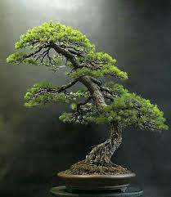
Bonsai styles
Slanting (Shakan)
This style depicts a tree that has tilted to one side due to wind or reaching for sunlight from a shaded area.
Characteristics: The trunk grows at an angle of roughly 60–80 degrees from the vertical. The roots on the side opposite
the lean
are typically more developed to visually anchor the tree.
How to Achieve:
Set the slant early in the tree's development using guy wires or strategic positioning.
Ensure the first main branch extends in the opposite direction of the lean to create visual balance.
Prune the crown to prevent it from becoming top-heavy on the leaning side.
A weighted pot or rock can help simulate the natural tension.

Slide 9
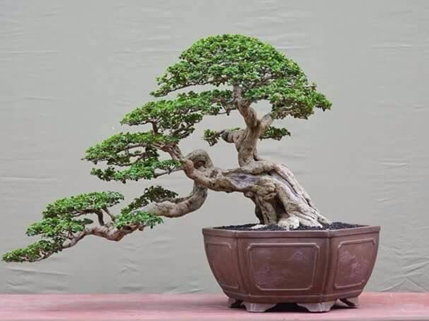
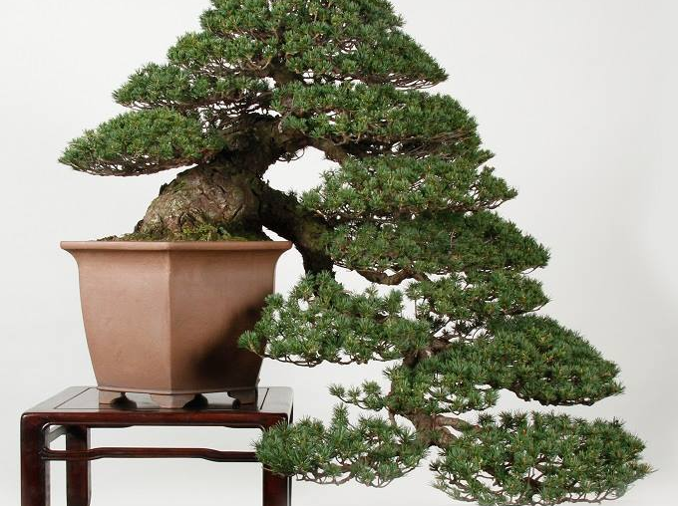
Bonsai styles
Cascade (Kengai) and Semi-Cascade (Han-kengai)
These styles emulate trees growing on steep cliffs, where the trunk grows downward.
Characteristics: The trunk grows upright for a short distance and then bends sharply downward. In a full cascade,
the growth extends below the base of the pot. In a semi-cascade, it reaches just to or slightly below the pot's rim.
How to Achieve:
Select hardy, flexible species that tolerate stress, such as Junipers or Pines.
Use a deep, sturdy pot to counterbalance the downward form.
Strong wiring and support rods are essential to guide the trunk's dramatic downward curve.
Water carefully, as gravity can cause uneven moisture distribution.

Slide 10
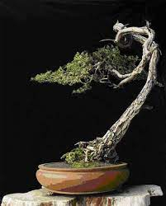
Bonsai styles
Literati (Bunjingi) Characterized by a long, slender, often twisted trunk with minimal branches and sparse foliage, usually near the top. This elegant style evokes an artistic, minimalist aesthetic.
  How to Achieve:
  Pruning: Remove most lower branches, encouraging the tree's energy to the top. Use wiring to create the desired twists and curves in the trunk.
  Potting: Often displayed in a small, round pot that provides stability without distracting from the form.

Slide 11
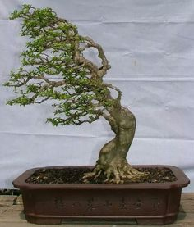
Bonsai styles
Windswept (Fukinagashi) This style gives the impression of a tree constantly battling a strong wind. The trunk leans, and all branches and foliage are swept to one side.
How to Achieve:
Shaping: Position the tree at a sharp angle and wire all branches to flow in the same direction, away from the "wind" source.
The roots on the windward side are often more exposed to show the struggle.

Slide 12

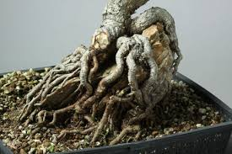
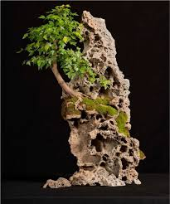
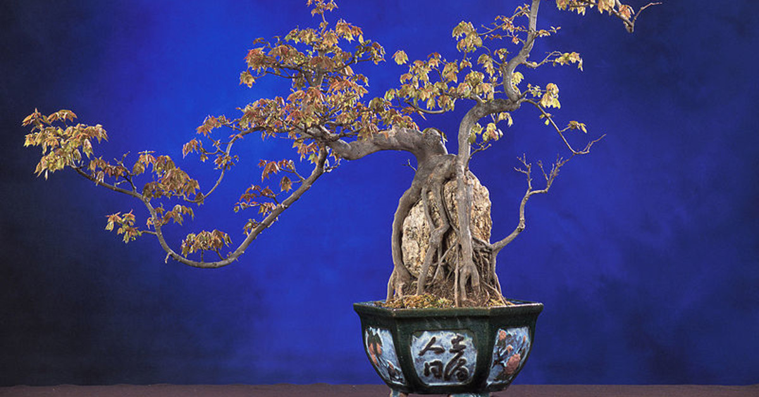
Bonsai styles
The root over rock (Sekijoju) bonsai style emulates a resilient tree growing on a rocky cliffside, with its roots clinging firmly to the rock face and reaching down into the soil below. This style emphasizes the struggle and strength of nature and requires patience, as the process takes several years to achieve.
Key Materials & Tree Selection
Tree:
Choose a young, healthy tree with a vigorous and flexible root system. Species with fast-growing roots that meld well to stone are ideal, such as:
  Trident Maple (Acer buergeranum)
  Ficus species
  Liquidambar (Sweetgum)
  Elms (Ulmus varieties)
  Junipers and Pines (require a grittier medium)
Rock: Select a rock that complements the tree's size and shape, with an interesting texture, natural fissures, cracks, and crevices to guide the roots. Avoid rocks that are too smooth or may release harmful substances into the soil.
Other supplies: Bonsai soil, a deep training pot, plastic wrap or aluminum foil, cotton twine or raffia, and "muck" (a sticky mixture of clay soil and peat moss).

Slide 13
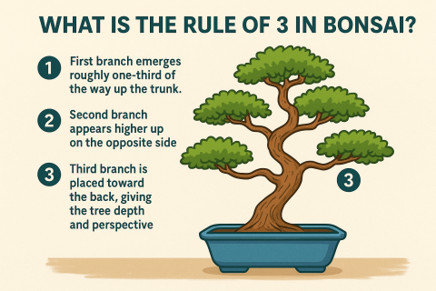
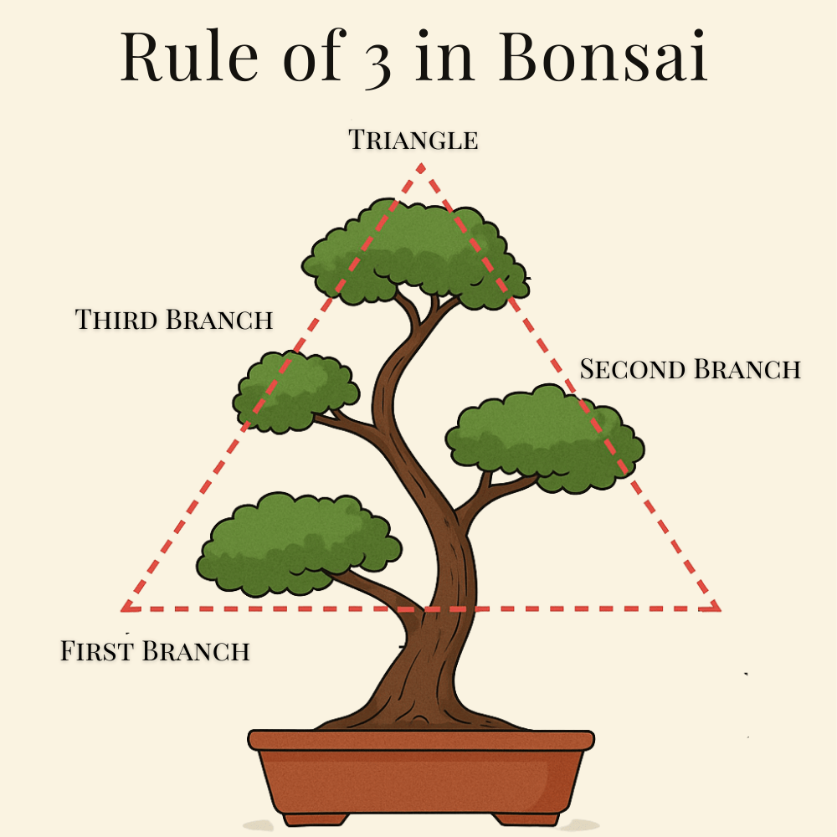
RULE OF 3
How to Apply the Rule of 3 to Your Bonsai
Step 1: Identify Your Tree’s Front
Before applying the Rule of 3, select the best viewing angle for your tree. This “front” should showcase the trunk’s movement and natural character.
Step 2: Divide the Trunk into Thirds
Mentally divide your tree’s height into three equal sections. Use this as a guide for:
Root spread and trunk base (lower third)
Primary branch development (middle third)
Fine branching and apex (upper third)
Step 3: Select Your First Three Branches
Starting approximately one-third up the trunk:
First branch (left): Should be your lowest and often thickest branch
Second branch (right): Positioned slightly higher, on the opposite side
Third branch (back): Creates depth and should point away from the viewer
Step 4: Continue the Pattern
As you move up the trunk, continue the left-right-back pattern. Space branches vertically so each receives adequate light and doesn’t crowd the branch below.
Step 5: Adjust for Your Tree’s Character
Remember: the Rule of 3 is a guide, not a law. Some trees may need slight variations based on their natural growth pattern.

Slide 14
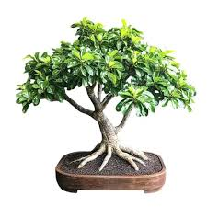
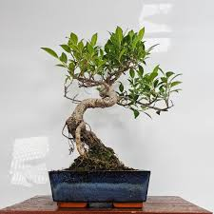
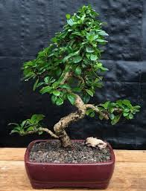
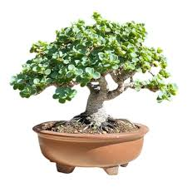
Best for begginers
(INDOOR)
The most popular and recommended trees for beginner bonsai enthusiasts include the Chinese Elm, Ficus,
and Juniper due to their hardiness, resilience, and tolerance of common beginner mistakes. Your choice will depend
on whether you plan to grow the bonsai indoors or outdoors.
Popular Indoor Bonsai Trees
Tropical and subtropical species thrive indoors in stable temperatures and lower humidity environments.
Ficus (Ficus retusa or Ficus microcarpa): Very resilient and tolerant of lower light and occasional missed waterings,
making it very forgiving for novices.
Dwarf Jade (Portulacaria afra): A succulent that stores water in its leaves, requiring minimal watering. This is perfect
for busy individuals but requires a bright, sunny position.
Fukien Tea Tree (Carmona microphylla): An evergreen tree that produces pretty white flowers during the summer
months and is suitable for warm indoor rooms.
Hawaiian Umbrella (Schefflera arboricola): An easy-to-care-for plant that is very tolerant of overwatering, a common beginner mistake

Slide 15
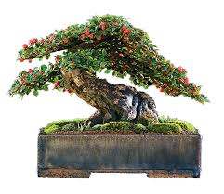
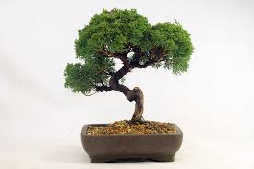
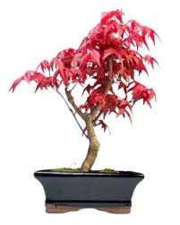
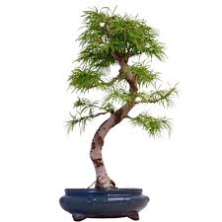
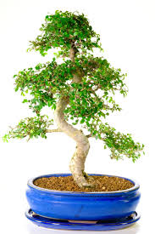
Best for begginers
(OUTDOOR)
Hardy, temperate trees need seasonal changes and should be kept outdoors
where they can experience winter dormancy.
Juniper (Juniperus): A classic choice known for its beautiful foliage and tolerance
of wiring and shaping techniques, making it ideal for learning the art of bonsai styling.
Japanese Maple (Acer palmatum): Prized for its stunning seasonal color changes
in autumn (reds, oranges, and yellows). It needs consistent moisture but is relatively
forgiving of pruning.
Cotoneaster: An incredibly hardy, "unkillable" species for beginners that produces
small leaves, white or pink flowers, and red berries.
Larch (Larix): A hardy deciduous conifer (it drops its needles in winter) that
grows vigorously and responds well to pruning
Chinese Elm (Ulmus parvifolia): Widely regarded as an ideal beginner's choice, it is hardy, adaptable, and responds well to pruning.
It has naturally small leaves and a classic miniature tree appearance.

Slide 16
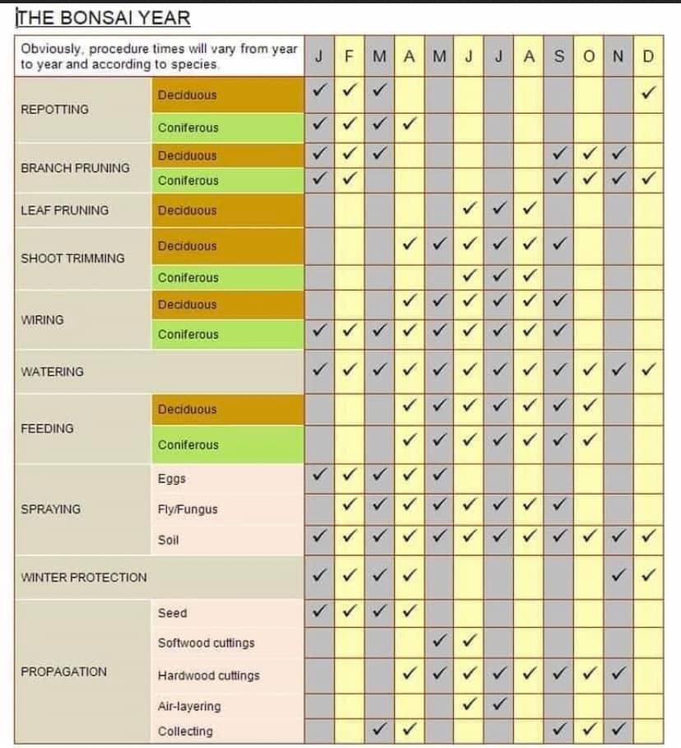
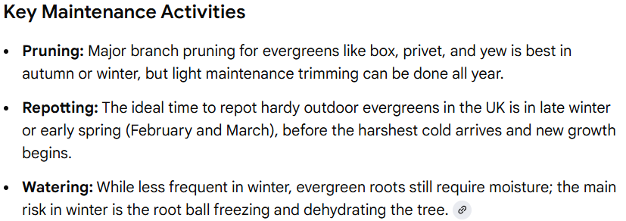
Bonsai care
A UK bonsai work calendar involves monthly tasks tailored to the season, covering
watering, pruning, repotting, and frost protection. Bonsai care is climate-dependent,
so specific timing can vary, but a general guide can be followed.
Year-Round Fundamentals
Watering: This is the most crucial task. Check daily, sometimes morning and evening during
warm weather. Only water when the soil looks light brown and feels damp; overwatering
causes root rot.
Maintenance Pruning: For outdoor bonsai, this is done throughout the growing season
(early spring to late autumn) to maintain shape. Indoor bonsai can be pruned all year.
Evergreen

Slide 17
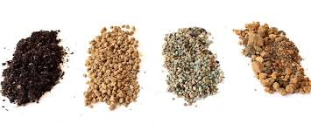
Bonsai Soil
Bonsai soil is typically a mix of inorganic, granular components designed for superior drainage, aeration, and moisture retention, rather than traditional organic garden soil.
The specific "type" often refers to the primary components used in the custom blend, which varies depending on the tree species and local climate.
Primary Inorganic Components
These materials form the structural basis of most quality bonsai soil mixes, ensuring the correct
balance of air and water in the root zone.
Akadama: A naturally occurring, hard-baked Japanese volcanic clay that is arguably the most
common and popular component.
Properties: Its granular structure provides excellent drainage while the individual particles absorb
and retain water and nutrients, releasing them slowly. The color darkens when moist, helping
growers determine when to water.
Considerations: It is relatively expensive due to importation and can break down into finer
particles over a few years, especially in freezing climates, which necessitates repotting.
Pumice: A soft, porous volcanic rock that is lightweight and highly effective at absorbing
water and nutrients while promoting aeration.
Properties: It is pH neutral and does not break down over time, providing long-term
structural integrity to the soil mix.
Considerations: Its light color can be an aesthetic issue for some growers, and it can be
sourced more cheaply from European sources compared to Japanese Ezo Grit.
Lava Rock: A hard, heavy, crushed volcanic material that enhances aeration and provides structure.
Properties: It helps with moisture retention but its structure means roots generally grow around, not into, the particles.
Considerations: It is often used in mixes with akadama and pumice to improve longevity and drainage, particularly in wet climates
Evergreen

Slide 18
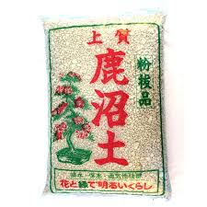
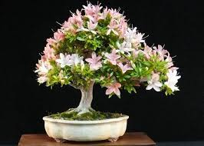
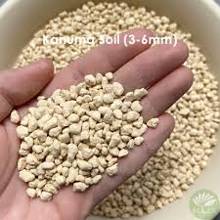
Bonsai Soil
Typical Mix Ratios
While the ideal mix depends on the specific tree, climate, and watering habits, general recommendations exist:
General Purpose Mix: A widely recommended basic mixture for most deciduous and broadleaf evergreen trees is 50% Akadama, 25% Pumice, and 25% Lava rock.
Conifers/Pines: A more free-draining mix is preferred, such as equal parts (1/3 each) of Akadama, Pumice, and Lava rock, or a mix featuring Kiryu.
Azaleas/Acid-loving species: These require a soil with a low pH and thrive in pure Kanuma soil. (ACIDIC) See below images.
Specialized Components
These materials are often included in specific mixes for certain species or conditions.
Kanuma: An acidic, light yellow volcanic material used exclusively for ericaceous (acid-loving)
plants like azaleas and camellias.
Properties: It has a low pH (around 4.5-6.0) and a soft, airy structure that allows roots to
penetrate the particles. It can be used on its own for these specific plants.
Kiryu (Kiryuzuna): A hard, heavy Japanese type of dense pumice that is moderately absorbent with
a neutral ph.
Properties: It is frost-proof and long-lived, making it suitable for pines and junipers which are rarely
repotted.
Considerations: It dries out quicker than other media and is typically mixed with other components
like akadama in climates that are not extremely dry.
Organic Materials: Finely chipped pine or fir bark and organic compost are sometimes added in small proportions to help retain moisture and support beneficial soil microbes (mycorrhizae).
Considerations: Organic materials break down faster than inorganic components, which can lead to soil compaction and poor drainage over time.

Slide 19
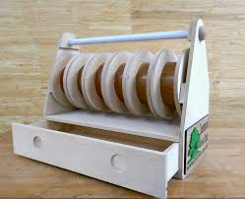
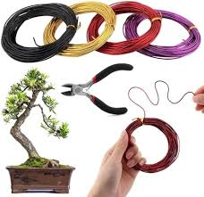
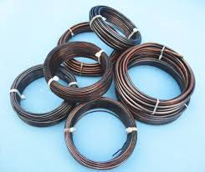
Wiring bonsai for beginners
Wiring is a fundamental bonsai technique for shaping the tree's trunk and branches. For beginners, it involves
using the correct wire (anodized aluminum is recommended), applying it with an angle of approximately 45 degrees,
and monitoring the tree closely to prevent damage.
Essential Materials
Bonsai Wire: Anodized aluminum wire is best for beginners and most deciduous trees because it is softer,
easier to apply, and less likely to scar the bark than copper wire. Common starting sizes (gauges) to purchase are 1mm, 1.5mm, 2.5mm, and 4mm.
Wire Cutters: Use proper bonsai wire cutters to safely remove the wire later. Standard wire cutters can also work.
Raffia (Optional): For thicker or more brittle branches, soak raffia (a palm fiber) in water and wrap it around the branch first to provide a protective layer and prevent splitting.

Slide 20
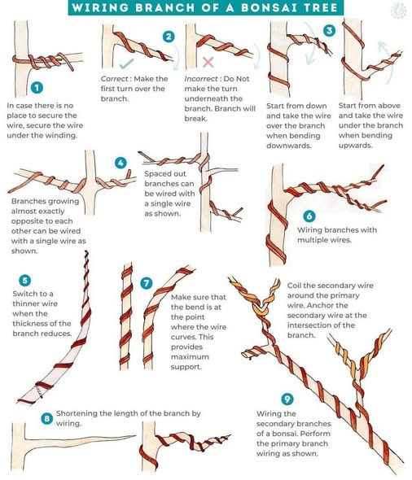
Step-by-Step Wiring Guide
Prepare the Tree: Only wire healthy and strong bonsai trees. It's easier to wire deciduous trees in late winter
or autumn when they have no leaves.
Select Wire Size: The wire should be about one-third the thickness of the branch you are wiring.
A good test is to press a short length against the branch; if it bends easily, it is too thin.
Cut the Wire: The wire length should be about one-third longer than the branch you are wiring.
Anchor the Wire:
For the Trunk/Main Branches: Anchor one end of a long piece of wire into the soil or around a strong, stable branch.
Double Wiring: Whenever possible, use one continuous piece of wire to style two branches of similar thickness that are
close to each other. Wrap the wire around the trunk once or twice between them for stability.
Apply the Wire:
Work from the trunk outwards to the primary branches, and then to secondary ones.
Wrap the wire at a consistent 45-degree angle along the branch. This angle provides the best holding power
while allowing the tree to grow.
Wrap the wire snugly but without excessive pressure, ensuring you can still potentially pass a sheet of paper between
the wire and the bark. Avoid crossing wires.
Shape the Branches:
  Once the branch is wired, gently bend it into the desired position.
  Use your fingers and thumbs to support the outside of the curve, applying force from the inside of the bend
  to minimize the risk of splitting.
  Add natural-looking movement and subtle bends to straight sections.
Monitor and Remove: Check the tree every 4-6 weeks, especially during the growing season, to ensure the wire
does not cut into the bark.
The wire should typically stay on for 2 to 6 months, or longer for slow-growing conifers, until the branch holds its new shape.
Always cut the wire off carefully with wire cutters; do not try to unwind it, which can damage the branch and new growth.

Slide 21
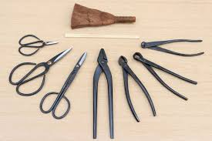
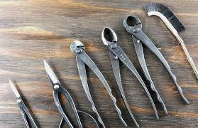
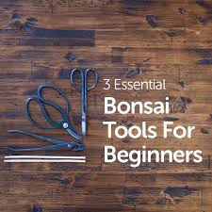
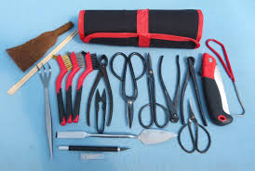
bonsai Tools for beginners
Beginners to bonsai need a few essential, specialized tools, including bonsai shears, concave cutters, and wire cutters, to ensure clean cuts that promote proper healing. While general gardening tools may seem sufficient, purpose-built bonsai tools are designed for the art's specific techniques.
Essential Individual Tools
Bonsai Shears: These are an all-purpose tool with long, slender handles and sharp, pointed blades, ideal for intricate tasks like precision trimming of leaves, shoots, and smaller branches. They are a fundamental tool that most growers use regularly.
Concave Cutters: This specialized tool is crucial for removing branches without leaving an unsightly scar. The concave jaws scoop a small, V-shaped indentation that encourages the callus tissue to grow level with the bark, allowing the wound to heal flush with the trunk. An 8-inch size is often recommended for beginners.
Bonsai Wire Cutters: These are designed with stubby, round jaws that allow you to cut training wire without damaging the tree's bark. Using regular household pliers or wire cutters can crush the bark and harm the tree.
Root Rake/Hook: An indispensable tool for repotting, a root rake (often with two or three prongs and sometimes a spatula on the end) helps to gently tease out and detangle roots and clear away old soil.
Tweezers with Spatula: A long pair of tweezers is useful for plucking spent needles or weeds, while the spatula end can help tamp down soil or apply cut paste.

